Slide 1
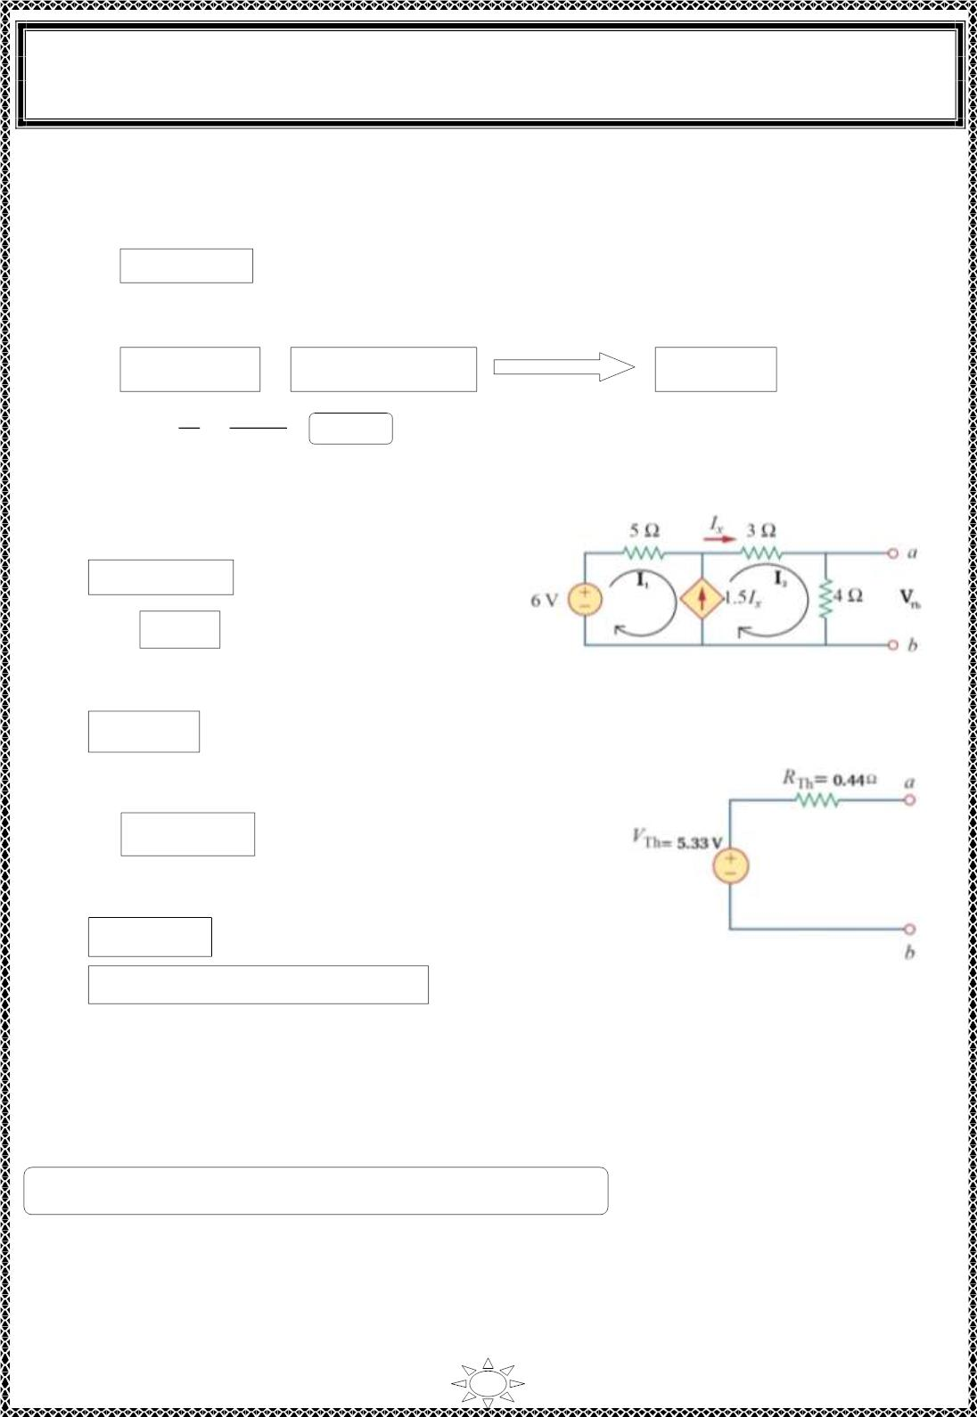
University of Diyala
Engineering College
Electronic Department
Electrical Engineering Fundamentals
1st Class
Asst., Lecturer : Wisam N. AL-Obaidi
Year (2013-2014)
For mesh (3)
4I – 4I = 1
2
3
∴ I –I = 0.25
…(5)
2
3
Solve Equ.s (3), (4), & (5), we get,
I = -2A = I , I = -2.25 A = - i
i_{o} = 2.25 A
2
x
3
o
푉
1 푉
표
∴ R = =
= 0.44 Ω
Th
ꢀ
2.25 퐴
표
❖ To find V_{Th} , use Mes h analysis on the original circuit as shown in f igure below,
For super mesh (1) & (2),
I = I + 1.5I
…(6)
…(7)
2
1
x
&
I_{x} = I₂
Trail Version
Trail Version
Trail Version
Trail Version
Trail Version
Trail Version
Trail Version
Trail Version
Trail Version
Trail Version
Trail Version
Trail Version
Trail Version
Substitute equation (7) in (6), we get,
Figure (7.8)
I₁ = -0.5I₂
…(8)
-6 + 5I + 3I + 4I = 0
1
2
2
∴ 5I + 7I = 6
…(9)
1
2
Substitute equation (8) in (9), we get,
I₂ = 1.33 A
V = 4 × I = 4 × 1.33 = 5.33 V
Figure (7.9 )
Th
2
H.W.:- Solve examp le (2) by using Nodal analys is.
81

Slide 2
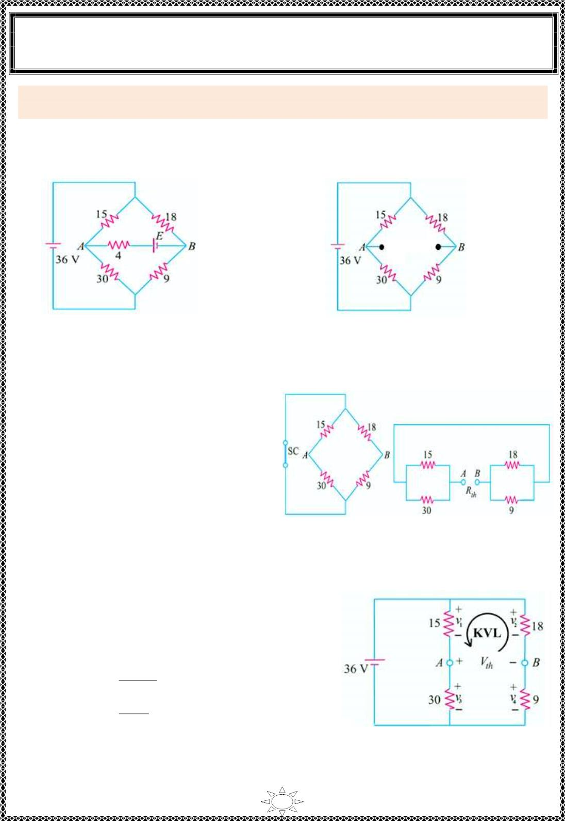
University of Diyala
Engineering College
Electronic Department
Electrical Engineering Fundamentals
1st Class
Asst., Lecturer : Wisam N. AL-Obaidi
Year (2013-2014)
Example 3: Find the current f lowing through the 4 Ω resistor of Figure (7.10) using
Thevenin theorem, if ( i) E= 2V and ( ii) E = 12V..
Solution:
When we remove E and 4 Ω resistor, the c irc uit becomes as shown in Figure (7.11).
Figure (7.10)
Figure (7.11)
Trail Version
Trail Version
Trail Version
Trail Version
Trail Version
Trail Version
Trail Version
Trail Version
Trail Version
Trail Version
Trail Version
Trail Version
Trail Version
❖ For find in g R_{th} i.e. the c irc uit
resistance as viewed from terminals
A and B, the battery has been short-
c irc u ited as shown in Figure (7.12),
we can redraw the circuit as shown
in Figure (7.13).
It is seen from Figure (7.13) that,
R = R = 15 || 30 + 18 || 9 = 16 Ω. Figure (7.12)
Figure (7.13)
th
AB
❖ We will f ind V = V with the help of Figure
th
AB
(7.11) and redraw it as shown in Figure (7.14).
To find voltages for each resistance we use
voltage divider rule,
v₁ = 36 ×
v₂ = 36 ×
15
= 12V
15+30
18
18+9
= 24V
Now apply KVL,
Figure (7 .14 )
V + v – v = 0
Th
1
2
∴ V = v – v = 24 – 12 = 12 V
Th
2
1
82

Slide 3
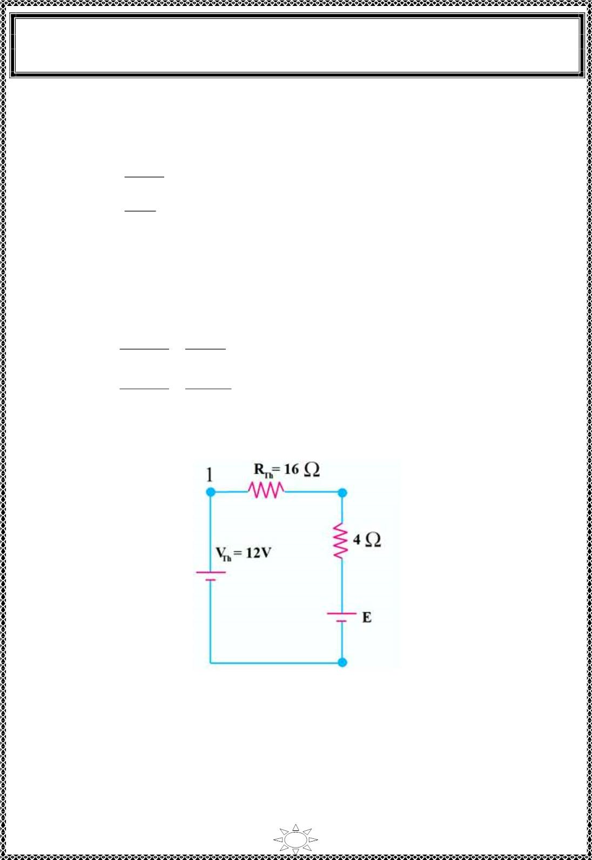
University of Diyala
Engineering College
Electronic Department
Electrical Engineering Fundamentals
1st Class
Asst., Lecturer : Wisam N. AL-Obaidi
Year (2013-2014)
Or ,
–V + v – v = 0
Th
3
4
∴ V = v – v
4
Th
3
30
v₃ = 36 ×
v₄ = 36 ×
15+30
9
= 24V
18+9
= 12V
∴ V = v – v = 24 – 12 = 12 V
Th
3
4
❖ The Thevenin's equivalent circuit is s hown in Figure (7.1 5).
The current through 4 Ω res istor is ,
^{V}_{Th} − E 12 − 2
(i)
I =
=
=
R_{Th} + 4 16 + 4
0.5 A
(ii) I =
^{V}_{Th} − E 12− 12
R_{Th} + 4 16 + 4
=
=
0 A
Trail Version
Trail Version
Trail Version
Trail Version
Trail Version
Trail Version
Trail Version
Trail Version
Trail Version
Trail Version
Trail Version
Trail Version
Trail Version
Figure (7 .15 )
83

Slide 4
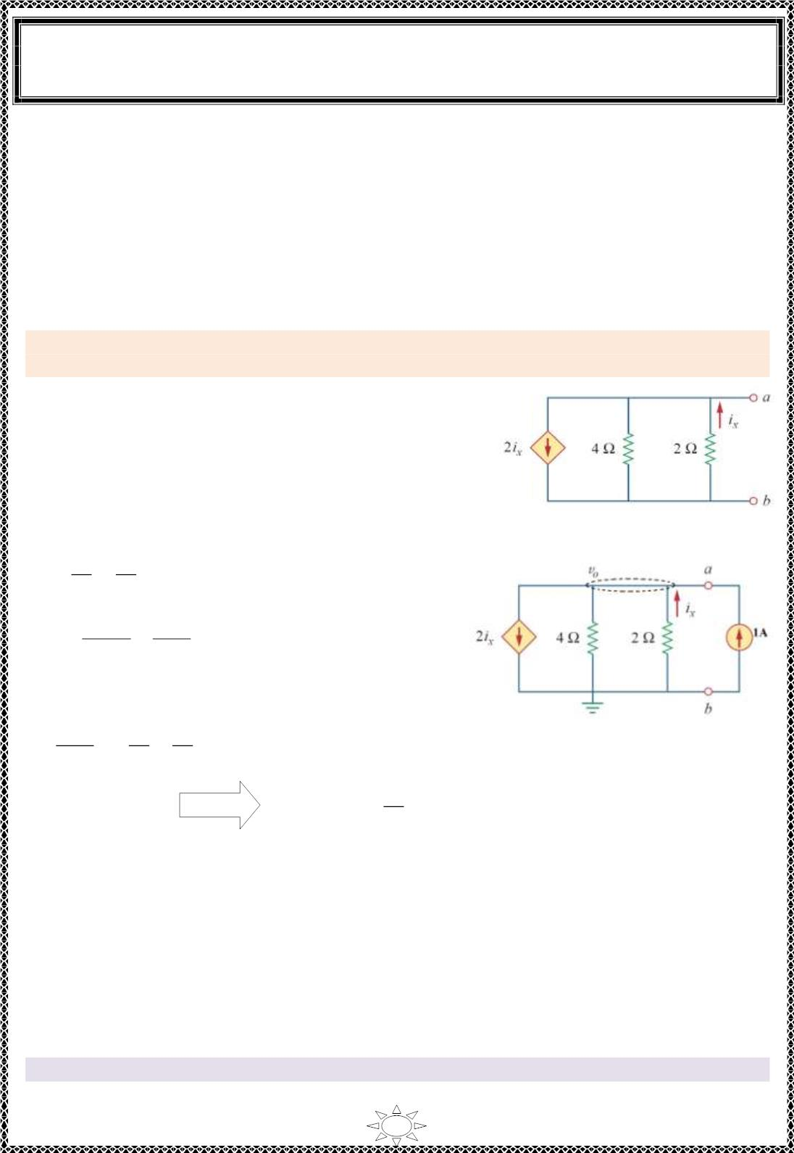
University of Diyala
Engineering College
Electronic Department
Electrical Engineering Fundamentals
1st Class
Asst., Lecturer : Wisam N. AL-Obaidi
Year (2013-2014)
Special Case: Circuit have dependent sources only (without independent sources)
When there exis t dependent sources o nly & there are not any independent source, then we
must exc ite the c ircuit externally. The simplest approach is to excite the circuit with either
a 1-V voltage source or a 1-A current source. Sinc e we will end up with an equivalent
resistance (e it her positive or negative).
In addit ion we will not have a va lue for Thevenin's equiva lent voltage (V_{Th} = 0); o nly R_{Th}
have a va lue which may be (e it her positive or negative).
Example 3: Determine the Thevenin equivalent of the circuit in Figure (7.16) at
terminals a-b.
Solution:
To find R_{Th}, apply a independent current source of 1A
across terminals a & b as shown in Figure (7.17).
Use nodal analys is to f ind the voltage across current
s ource,
Figure (7.16)
Trail Version
Trail Version
Trail Version
Trail Version
Trail Version
Trail Version
Trail Version
Trail Version
Trail Version
Trail Version
Trail Version
Trail Version
Trail Version
^{푣}표
2i_{x} +
4
푣_{표}
2
−
+
1 = 0
…(1)
…(2)
& i_{x} =
0− 푣_{표} − 푣_{표}
2
=
2
Substitute Equ. (2) in (1) we get,
^{− 푣}표
2
푣_{표} 푣_{표}
2
ꢀ
−
1 = 0
+
+
Figure (7.16)
4
2
∴ v_{o} = −ퟒ퐕
^{푣}표
1
−
∴ R_{Th} = = ퟒ Ω
The negative value of the resistance t ells us that, according to the passive sign convention,
the c ircuit in Figure (7.16) is supplying power. Of course, the res istors in Figure (7.16)
cannot s upp ly power (they absorb power); it is the dependent source that supplies the
power. This is an examp le of how a dependent source and resistors c ould be used to
simulate negative res istance.
We know th is is not poss ible in a passive c irc uit, but in this circuit we do have an active
device (the dependent current source). Thus, the equivalent circuit is essentially an active
circuit that can supply power.
Note that as there is no independent source in the original c ircuit, then V_{Th} = 0 V.
84

Slide 5
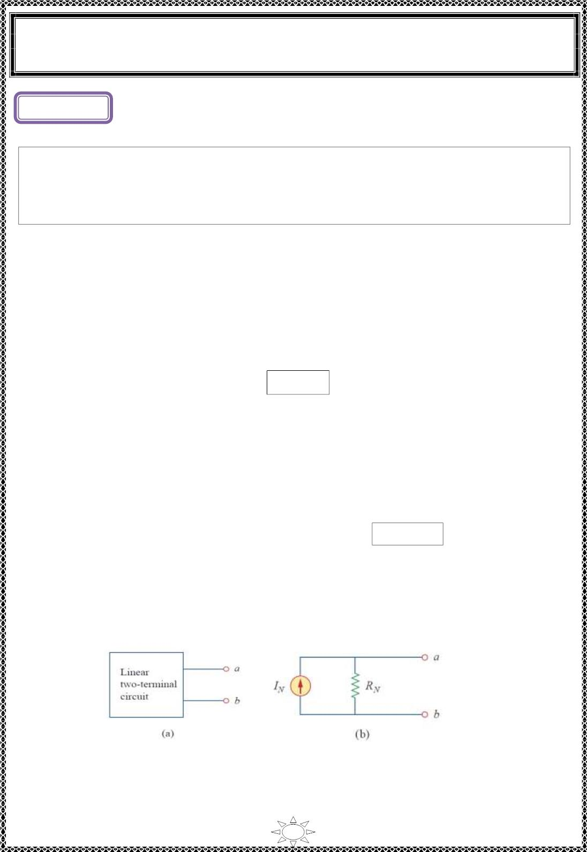
University of Diyala
Engineering College
Electronic Department
Electrical Engineering Fundamentals
1st Class
Asst., Lecturer : Wisam N. AL-Obaidi
Year (2013-2014)
L ectur e (8)
Norton’s Theorem
Norton‘s theorem states that a linear two-terminal circuit can be replaced by an
equiva le nt circuit consisting of a current source I in parallel with a res istor R , where I
N
N
N
is the short-circuit current through the ter mina ls and R_{N} is the input or equivalent
resistance at the terminals when the independent sources are turned off.
How to find Norton's equivalent circuit
This procedure is based on the first statement of the theorem given above.
1. Remove the resistance ( if any) across the two given terminals and put a short c irc uit
across them.
2. Compute the short-circuit current i_{sc}.
^{I}N ^{= i}
sc
Trail Version
Trail Version
Trail Version
Trail Version
Trail Version
Trail Version
Trail Version
Trail Version
Trail Version
Trail Version
Trail Version
Trail Version
Trail Version
3. Remove all vo ltage sources but retain their internal res istances, if any. Similarly,
remove all current sources and replace them by open-circuits.
4. Next, find the res istance R_{N} of the network as looked into from the give n ter mina ls . It is
exac t ly the same as R_{Th}.
Note:the procedure for finding Norton's equiva lent resistance is the same as the as the
^{R}N ^{= R}
Th
procedure for find in g Thevenin's equivalent res istance, so
5. The current source (i ) joined in parallel across R between the two terminals gives
sc
N
Norton‘s equivalent c irc uit.
Thus, the circuit in Figure (8.1)(a) can be replaced by the one in Figure (8.1)(b).
Figure (8.1): (a) Original circuit, (b) Norton equivalent c ircuit.
85

Slide 6
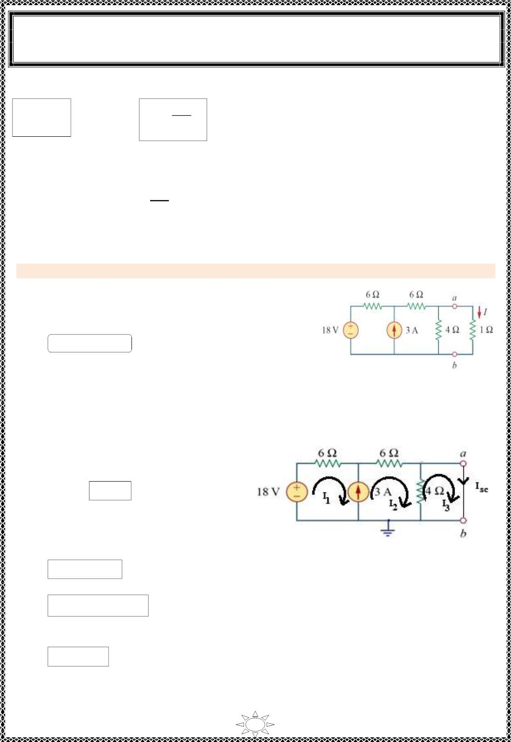
University of Diyala
Engineering College
Electronic Department
Electrical Engineering Fundamentals
1st Class
Asst., Lecturer : Wisam N. AL-Obaidi
Year (2013-2014)
Observe the close rela t io ns hip between Norton‘s and Thevenin‘s theorems:
R_{N} = R_{Th}
and
I =
N
^{V}Th
^{R}Th
This is essentially source transformation. For this reason, source transformation is often
called Thevenin-Norton transformation.
푣
V = v , I = i , R =
표푐
= R_{N}
Th
oc
N
sc
Th
ꢀ푠푐
Example 1: Us ing Norton‘s theorem to solve (Example (1) of Thevenin's Theorem).
Solution:
❖ We find R in the same way as we f ind R , so,
N
Th
Trail Version
Trail Version
Trail Version
Trail Version
Trail Version
Trail Version
Trail Version
Trail Version
Trail Version
Trail Version
Trail Version
Trail Version
Trail Version
R = R = 3 Ω
N
Th
Fig ure (8.2)
❖ To find (I_{N}) we must short the
terminals a & b to find the sort
circuit current I_{sc},
Where I_{N} = I_{sc}
Use Mesh analysis,
For super mesh (1) & (2),
I = I – 3
…(1)
Figure (8.3)
1
2
-18 + 6I + 6I + 4(I – I ) = 0
1
2
2
3
3I + 5I – 2I = 9
…(2)
1
2
3
Substitutes Equ.s (1) in (2), we get,
4I –I = 9 …(3)
2
3
86

Slide 7
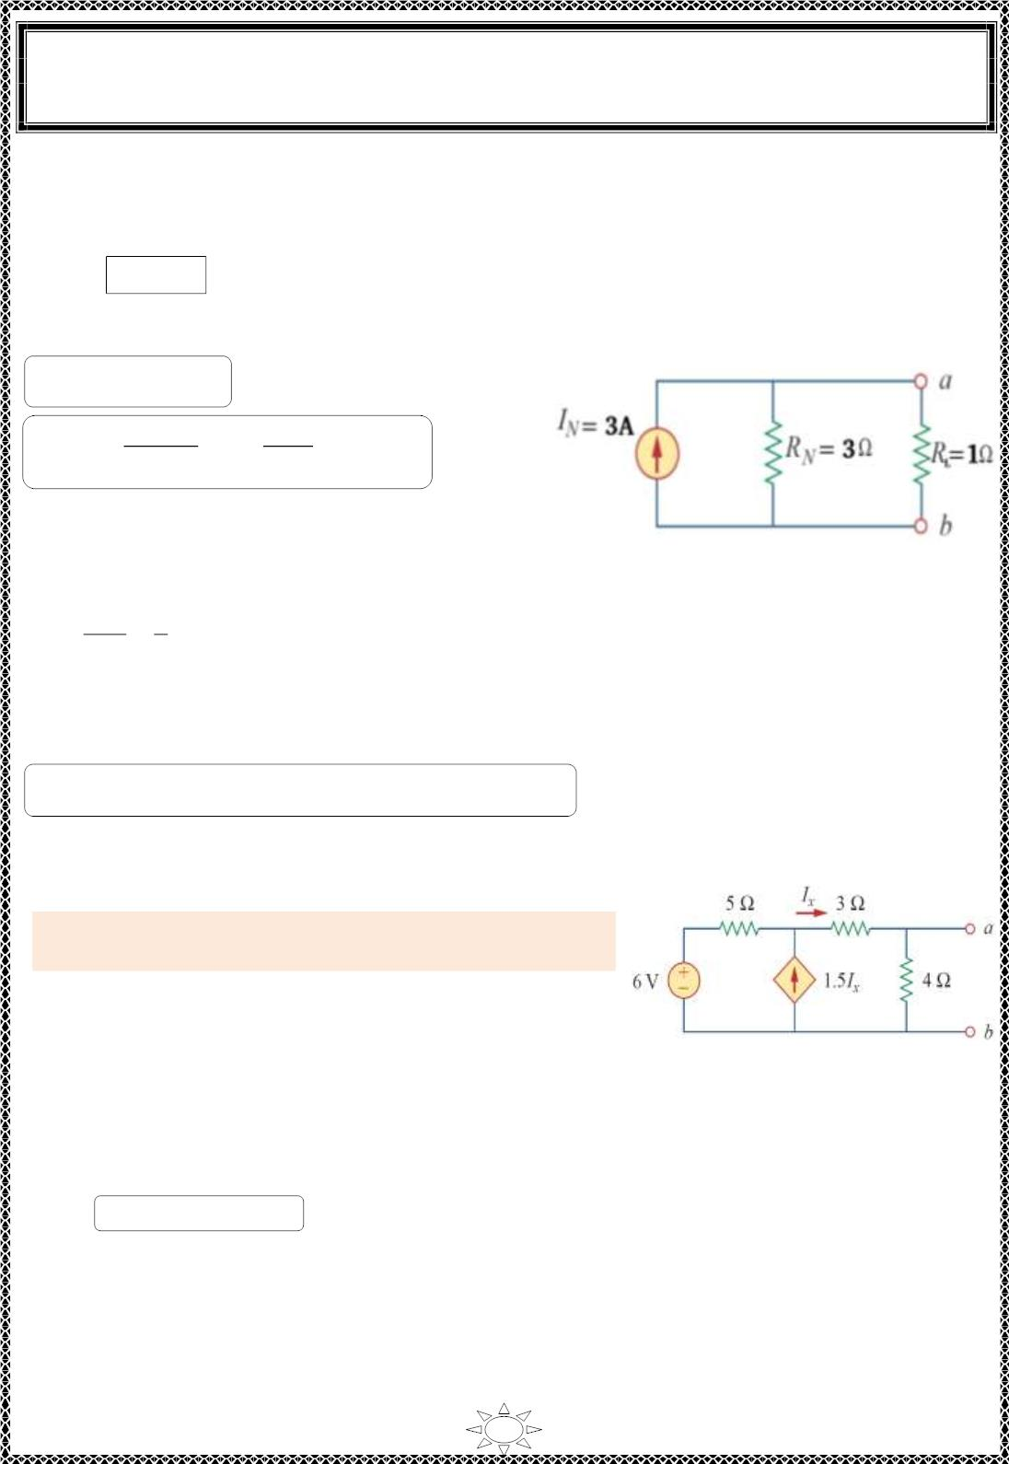
University of Diyala
Engineering College
Electronic Department
Electrical Engineering Fundamentals
1st Class
Asst., Lecturer : Wisam N. AL-Obaidi
Year (2013-2014)
For mesh (3),
4(I – I ) = 0
3
2
∴ I₂ = I₃
…(4)
Substitute Equ. (4) in (3), we get,
I = 3A = I = I
3
sc
N
I = I ×
푅_{푁}
푅_{푁} + 푅_{퐿}
= 3×
3
= 2.25 A
L
N
3+ 1
Also short circuit current can be found by,
Figure (8.4)
^{푉}푇ℎ
푅_{푇ℎ}
9
3
I =
N
=
= 3A
Trail Version
Trail Version
Trail Version
Trail Version
Trail Version
Trail Version
Trail Version
Trail Version
Trail Version
Trail Version
Trail Version
Trail Version
Trail Version
H.W./ Solve examp le (1) by us ing Nodal analys is.
Example 2: F ind Norton‘s equivalent c ircuit of
(Example (2) of Thevenin's Theorem).
Solution:
Figure (8.5)
❖ We find R in the same way as we f ind R , so,
N
Th
R = R = 0.44 Ω
N
Th
87

Slide 8
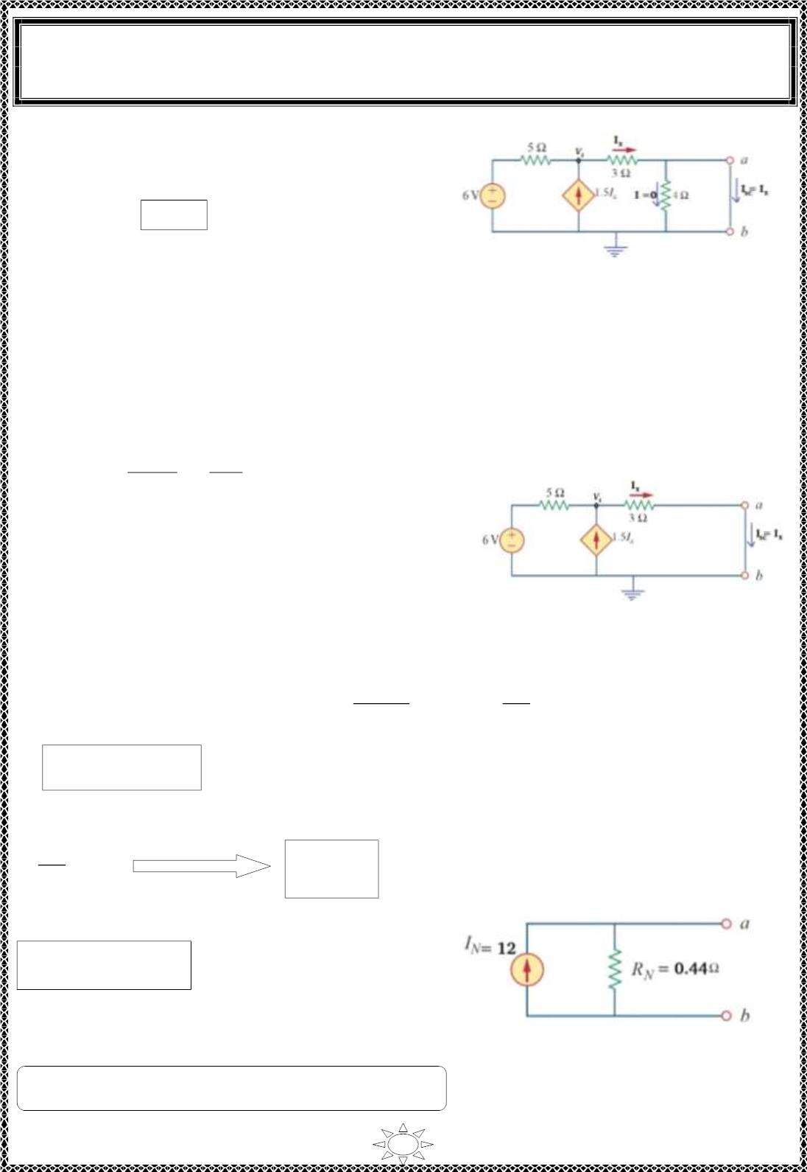
University of Diyala
Engineering College
Electronic Department
Electrical Engineering Fundamentals
1st Class
Asst., Lecturer : Wisam N. AL-Obaidi
Year (2013-2014)
❖ To find (I_{N}) we must short the terminals a &
b to find the sort circuit current I_{sc},
Where I_{N} = I_{sc}
Fig ure (8.6)
❖ The S.C. remove the parallel resistances with it, i.e. (4Ω resistor) because the
current will not flo w in the (4Ω resistor) but tends to flo w in the S.C. path ( because
it has resistance of zero Ω).
Equiva lent resistance of (4Ω resistor) & (S.C. resistor) is,
4×푅_{푠푐}
4+푅_{푠푐}
4×0
4+0
R =
eq
=
= 0 Ω = R_{sc}
The c irc uit can be redrawn as shown in figure.
Trail Version
Trail Version
Trail Version
Trail Version
Trail Version
Trail Version
Trail Version
Trail Version
Trail Version
Trail Version
Trail Version
Trail Version
Trail Version
Figure (8.7)
Use Nodal analysis to find I_{sc,}
∴ 8V – 22.5 I = 18
^{V}1 ⁻ ⁶
–
V₁
3
=
0
5
1.5 I_{x} +
1
x
…(1)
It is clearly from f igure that,
^{V}1
3
=
I_{x}
V₁ = 3 I_{x}
…(2)
Substitute Equ. (2) in (1) we get,
I = 12 A = I = I
x
sc
N
Fig ure (8.8)
H.W./ Solve examp le (2) by us ing Mes h analys is.
88

Slide 9
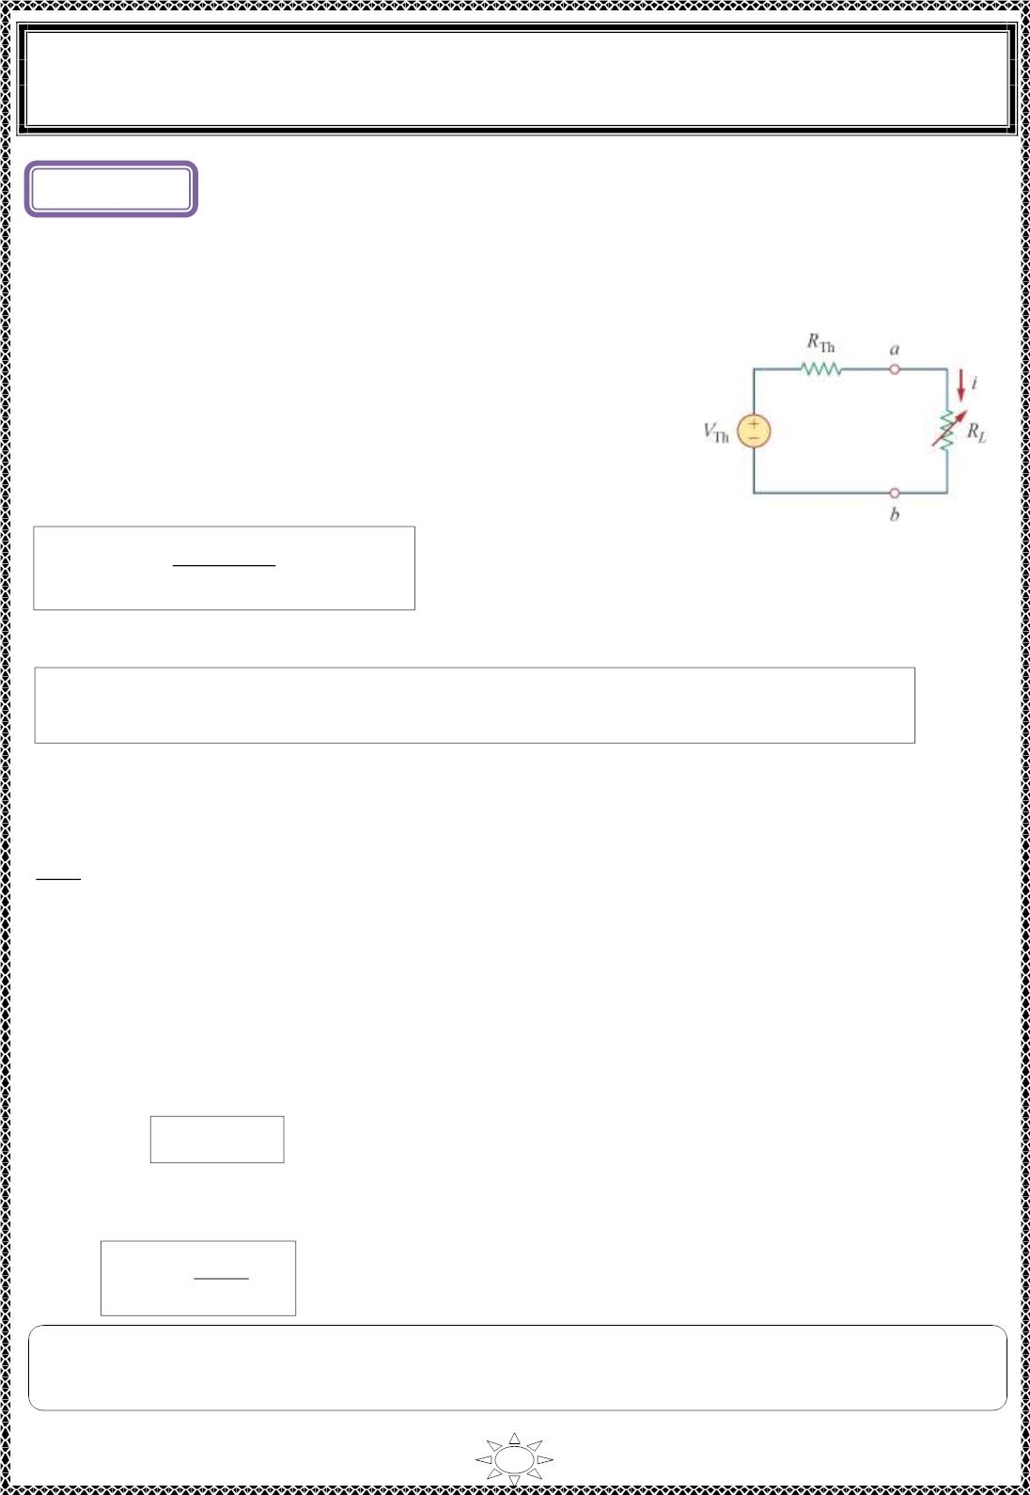
University of Diyala
Engineering College
Electronic Department
Electrical Engineering Fundamentals
1st Class
Asst., Lecturer : Wisam N. AL-Obaidi
Year (2013-2014)
L ectur e (9)
Maximum Power Transfer
In many practical s ituations, a c irc uit is designed to provide power to a load. There are
applic at ions in areas such as c ommunic at ions where it is desirab le to maximize the power
delivered to a load.
The Thevenin equivalent is useful in find ing the maximum
power a linear c ircuit can deliver to a load. We assume that
we can adjust the lo ad resistance R_{L} If the ent ire circuit is
replaced by its Thevenin equivalent except for the load, as
shown in Figure (1), the power delivered to the lo ad is
^{푉}푇ℎ
푅_{푇ℎ} + 푅_{퐿}
2
2
ꢀ × R
P = i R =
…(1)
Figure (9.1):The c irc uit used for
L
L
maximum power transfer.
Trail Version
Trail Version
Trail Version
Trail Version
Trail Version
Trail Version
Trail Version
Trail Version
Trail Version
Trail Version
Trail Version
Trail Version
Trail Version
Maximum power is transferred to the lo ad when the lo ad resistance equals the
Thevenin resistance as seen from the lo ad (R = R ).
L
Th
To prove the ma x imum power transfer theorem, we d ifferentiate p in equat ion (1) wit h
respect to R_{L} and set the result equal to zero. We obtain,
2
푑푝
ꢂ푅_{푇ℎ} + 푅 ꢃ − 2푅 ꢂ푅
_{푇ℎ} + 푅_{퐿} ꢃ_{ꢄ}
= 푉 ꢁ
퐿
퐿
2
푇ℎ
푅_{푇ℎ} + 푅_{퐿}ꢃ4
푑푅_{퐿}
ꢂ
ꢁ^{푅푇ℎ}
^{+ 푅}퐿^{− 2푅}
푅_{푇ℎ} + 푅_{퐿}ꢃ3
퐿
2
ꢄ = 0
= 푉
푇ℎ
ꢂ
This implies that
0 = (R +R – 2R ) = ( R – R )
Th
L
L
Th
L
This yields
R_{L} = R_{Th}
…(2)
The maximum power transferred is obtained by substitut ing Eq. (2) in to Eq. (1), for
2
P =
max
^{V}Th
…(3)
4R_{Th}
Note: Equat ion (3) applies o nly when R = R . When R ≠ R , we compute the power
L
Th
L
Th
delivered to the lo ad using Eq uat ion (1).
89

Slide 10
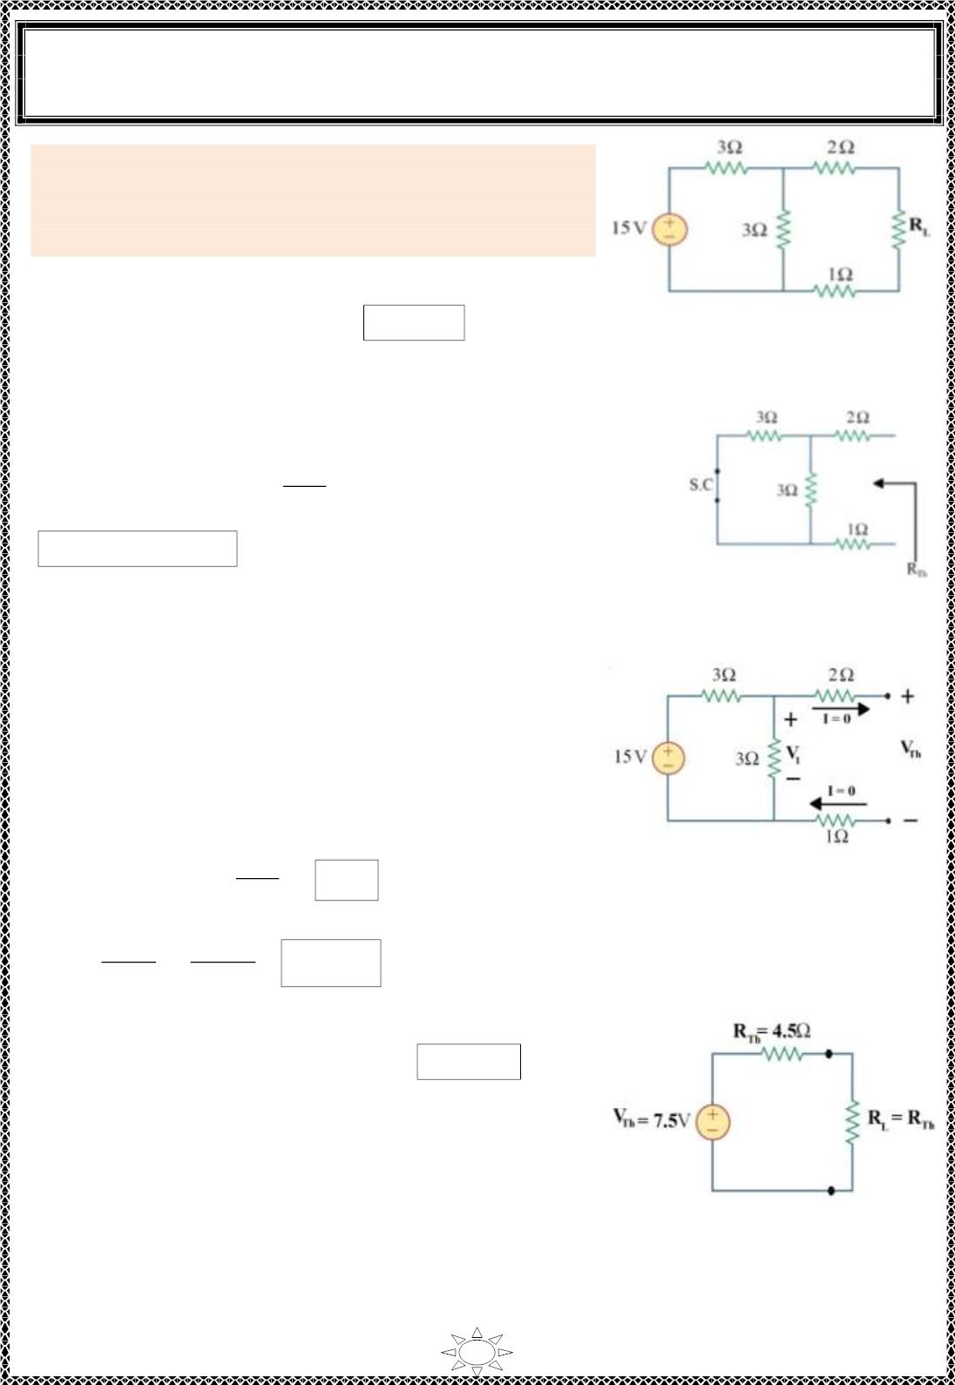
University of Diyala
Engineering College
Electronic Department
Electrical Engineering Fundamentals
1st Class
Asst., Lecturer : Wisam N. AL-Obaidi
Year (2013-2014)
Example 1: Find the value of R_{L} such that maximum
poss ible power will be transferred to R_{L}. Find also the
value of the maximum power and the power supplied by
source under these condit ions .
Solution:
For maximum power transferred, R_{L} = R_{Th}
Figure (9.2)
To find R , remove R & short the independent voltage source.
Th
L
3×3
∴ R = 3ꢀ3ꢂ + 2 + 1 = ꢃ ꢄ + 2 + 1 = 4.5 Ω
Th
3+3
R = R = 4.5 Ω
L
Th
Figure (9.3)
Trail Version
Trail Version
Trail Version
Trail Version
Trail Version
Trail Version
Trail Version
Trail Version
Trail Version
Trail Version
Trail Version
Trail Version
Trail Version
Now for find ing V_{Th} note that in th is circuit,
V_{Th} = voltage across (3Ω) res is tor because there is no
current f lows in (2Ω) & (1Ω) resistors because these
resistors are open.
3
∴ V = V = 15 × ꢃ ꢄ = 7.5 V , [voltage divider rule]
Figure (9.4)
Th
1
3+3
7.5²
2
V
P_{max.}
Th
=
=
3.125 W
=
4R_{Th}
4 ×4.5
Sinc e the same power is developed in R_{Th}, so power
supplied by the source is = 2 × 3.125 = 6.250 W
Figure (9.5)
90

